Slide 1
Mobile-to-Mobile Video Recommendation
Seshadri Padmanabha Venkatagiri, Mun Choon Chan, Wei Tsang Ooi
School of Computing, National University of Singapore
Notes:
OM NAMO GANAPATHAYEN NAMAHA

Slide 2

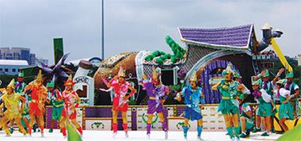
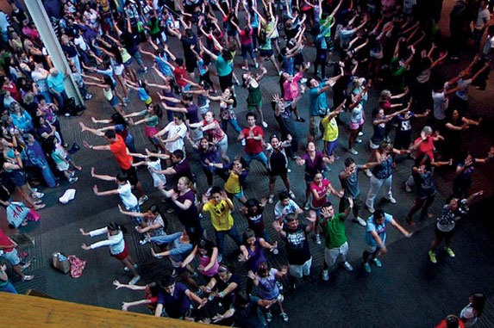
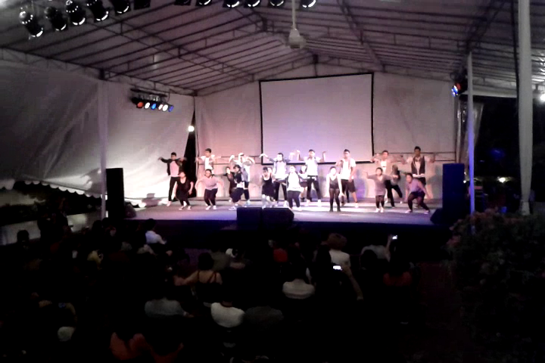
Adhoc social events

Slide 3
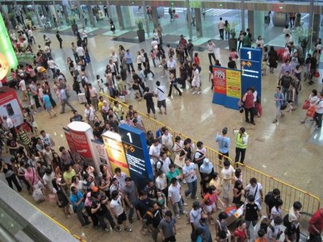
Shopping Malls

Slide 4
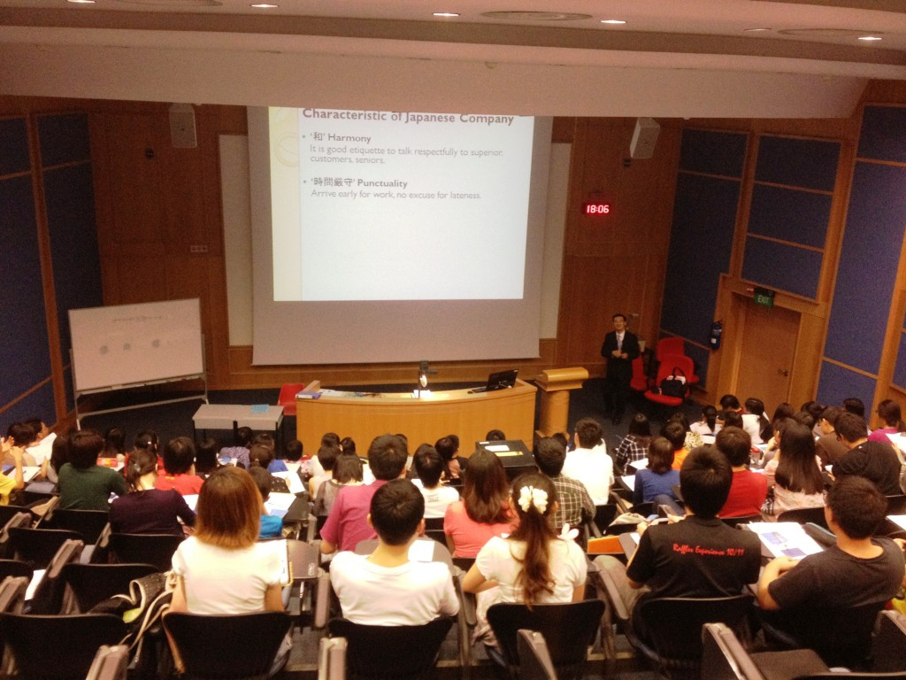
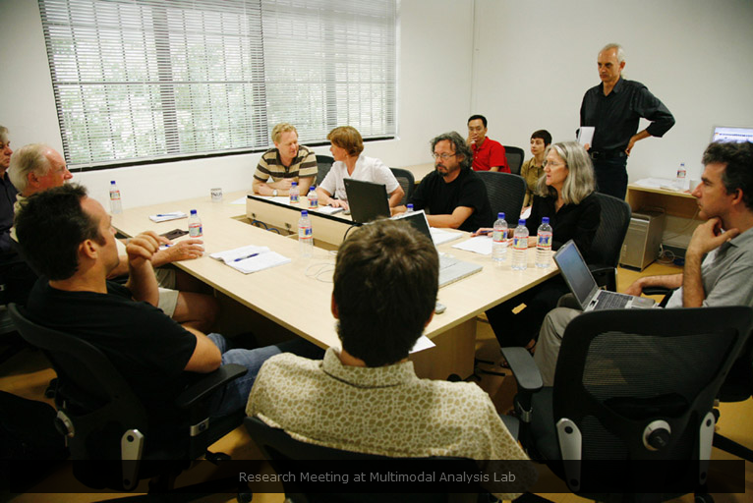
Interactive events

Slide 5
User Generated Content(UGC)
People want to generate and exchange content, both locally and with the Internet
Content could be:
Promo of some product
Video clip of a goal event in a soccer game
Part of a lecture
Dance/Song performance
Etc..
Such content is “User generated content”
Has “in-situ” value

Slide 6
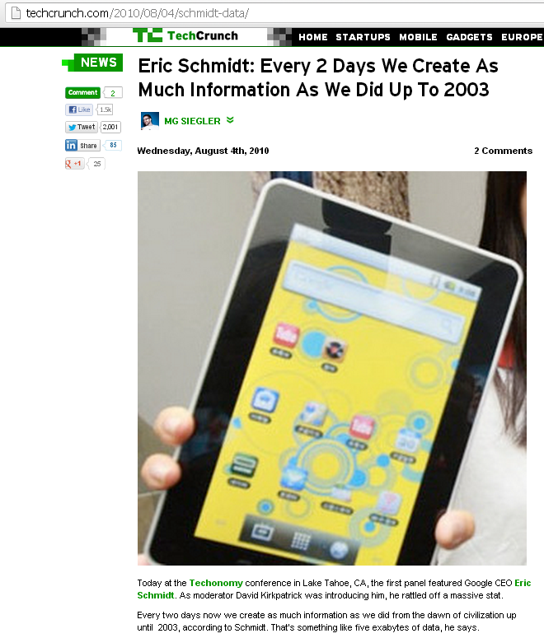
UGC is growing exorbitantly….

Slide 7
Constraints that inhibit the exchange of UGC

Slide 8

Smart Phone Battery
Communication over 3G/HSPA consumes four to six times more power for file transfer than WiFi.

Slide 9
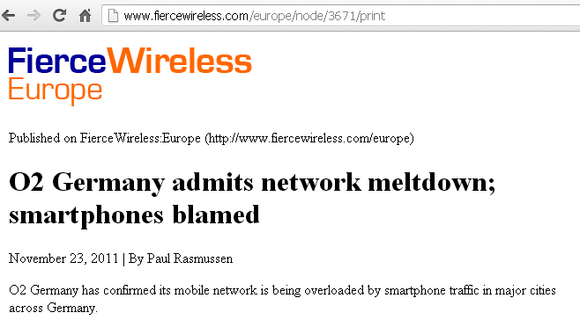
Bandwidth….
3G/HSPA network not optimized for upload
Download has been stressed due to increasing volume of traffic.

Slide 10



Some Bandwidth Measurements to Show Limitations of 3G/HSPA links
3G/HSPA
14MB Clip
5 Trials
Max: 1.9Mbps
Measured: 57Kbps
RTT: 70ms
Max: 7.2Mbps
Measured: 1125.2Kbps
RTT: 5.5ms
WiFi AdHoc
Max: 72.2Mbps
Measured: 22.6Mbps

Slide 11
Solution: “Use Mobile-to-Mobile Network for content dissemination”

Slide 12
But, existing M2M Solutions...
Do not personalize content
delivery based on such
similarity in users’ taste
Users cannot discover
content they do not know
Network cannot predict
individual user interest
accurately

Slide 13
Enter: Memory Based Collaborative Filtering(MCF)
Mainstream solution for personalization of content.
Studied extensively in conventional Internet
Demonstrated its practicality in many popular systems such as Amazon.com, YouTube.
Simple to design and implement

Slide 14
How MCF Solves these Limitations?
MCF captures abstract user taste based on taste of similar minded people using a Rating matrix
Content independent.
MCF is model independent.
It learns a rating matrix which is the basis of ranking content. By changing the rating matrix, the same algorithm could be reused in a different context.

Slide 15
But…
Conventional MCF: designed for central server
P2P MCF: don’t address the factors affecting M2M data dissemination

Slide 16
Our Proposal: Collaborative Filtering Gel (CoFiGel)
MCF
M2M
Transmission
Scheduler
CoFiGel
On-Device
Storage Manager

Slide 17
Challenge 1: Resource Constraints in M2M

Slide 18




Data dissemination depends on…
Limited Storage
How long Connection lasts?
How many copies of file exist?
How often do nodes meet?

Slide 19
Challenge 2:
Coverage Vs User Satisfaction

Slide 20
Consider a Rating Matrix…
Users/Items | i₁ | i₂ | i₃ | i₄ | i₅ | i₆
u₁ | 1
u₂ | 1
u₃ | 1 | 1 |  |  |  | 1
u₄ |  | 1 |  | 1 | 1 | 1
u₅ |  |  | 1 | 1
u₆ | 1 |  |  |  | 1 | 1
u₇ | 1 | 0 |  |  | 0 | 1
Predicted Ratings
Unknown Ratings

Slide 21
Definitions: Coverage, User satisfaction
Coverage
Measure of predictability of the MCF
Number of ratings available in rating matrix
18 ratings available in our rating matrix
User Satisfaction
Measure of user’s interest in a content
For eg: User u₁ likes item i₁, rating matrix indicates 1. User u₅ dislikes content i₇, rating matrix indicates 0
Idea is to increase the number of 1’s in the rating matrix

Slide 22
Predicting User Satisfaction
Compute Similarity between items i and j using cosine based similarity:
Compute rank by aggregating similarity of with i with all items previous rated by user u:

Slide 23
Coverage Vs User Satisfaction
(u₄,i₁)
(u₅,i₁)
i₁ has higher rating
(u₄,i₃)
(u₃,i₃)
(u₆,i₃)
(u₇,i₃)
i₃ has higher coverage

Slide 24
Coverage Vs User Satisfaction
Choice of item (i₁ or i₃)
Growth of Rating Matrix
Accuracy of Prediction
Items most interesting to user are disseminated
To allocate resources to an item or not

Slide 25
Problem Summary
Find a ranking of items, such that for every item delivered:
Coverage
Number of positively rated items
Number of users receiving positively rated items
Within the limits of available:
Contact opportunity
On-Device Storage

Slide 26
Solution: CoFiGel Algorithm
Whenever a pair of mobile devices come in contact, compute the following utility and transmit the content in decreasing order of utility value:
U_{i} = (g⁺_{i} + r⁺_{i}) * G_{i} * D_{i}
Likelihood of delivering an item within deadline ‘t’
Total Number of correctly predicted positive ratings, g⁺_{i} represents predictions, r⁺_{i} represents verified ratings.
Likelihood of number of correct predictions

Slide 27
Utility: G_{i}
G_{i} is the right hand size of below inequality:
More Predictions
Item Priority
Correct Predictions

Slide 28
Utility: D_{i}
D_{i} is the right hand size of below inequality:
Ratio of nodes not having the item to having it
Contact bandwidth
Item Priority
Waiting time in node buffer queues

Slide 29
Evaluation

Slide 30
Summary
Parameters | Values
Mobility Trace | RollerNet
Rating dataset | MovieLens (100K ratings)
Number of Publisher and Subscriber Nodes | 10 and 30
(Item publisher rate)/publisher and item lifetime | 40 items/Hr and 1 hour 15 min
Simulation duration, warmup and cool down time | Approx.3 Hrs, 1 Hr and 0.5 Hr
Item size and Buffer size | 15MB and 1GB
Default contact bandwidth | 3Mbps

Slide 31
Baseline Strategies
NoDeliveryTime
No contact history and time constraints
NoCoverage
Does not maximize coverage. Delivers items based on rating only
NoItemRecall
Does not perform multi-round predictions like CoFiGel

Slide 32
Baseline Strategies
CoFiGel3G
Similar to CoFiGel.
Metadata uploaded through always-on control channel
Data delivered over M2M network
Ground Truth
Obtained from the rating dataset

Slide 33
Metrics
Prediction Coverage
Number of ratings that could be predicted
Fraction of Correct Positive Predictions (FCPP)
Ratio of correct positive predictions to actual positive predictions(ground truth)
Precision
Ratio of number of relevant items that were recommended to number of recommended items

Slide 34
Metrics
Number of items delivered that are rated positively
Number of satisfied Users
Users who received at least one item that they rated positively are considered satisfied users

Slide 35
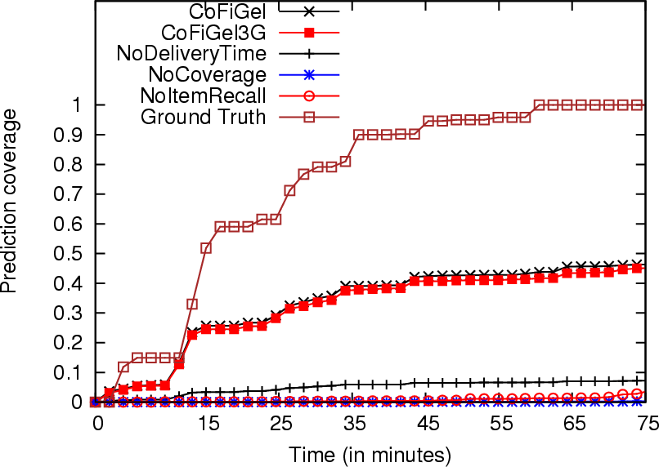
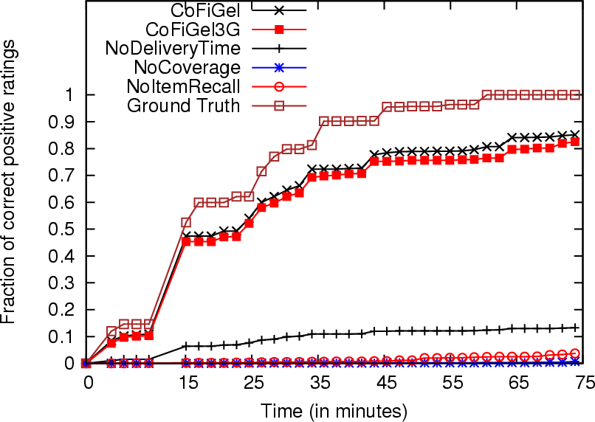
Coverage over Time
CoFiGel discovers 45% of all ratings and 84% of correct positive ratings, while baseline discovers 20% or less

Slide 36
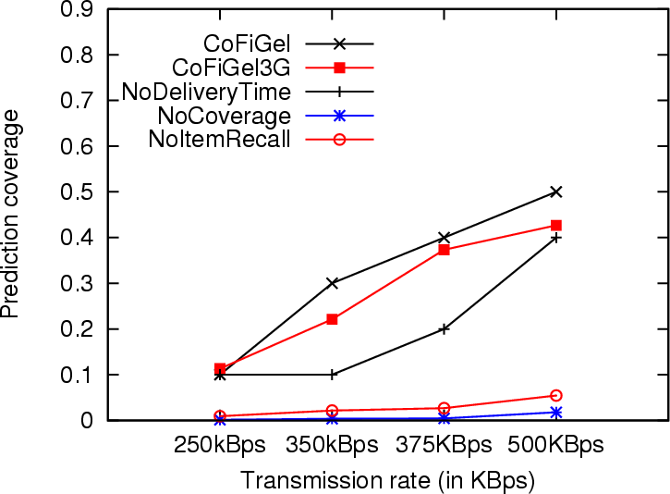
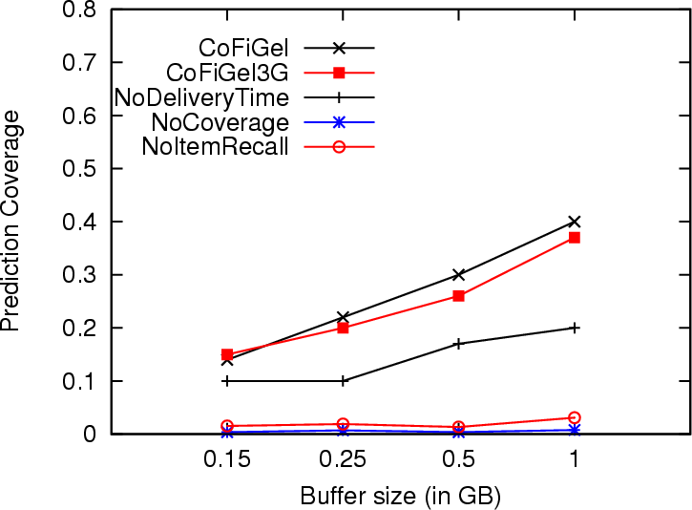
Coverage under resource constraints
Discovers upto 100% more ratings than baseline
Discovers upto 40% more ratings than baseline

Slide 37
CoFiGel3G
CoFiGel3G slightly underperforms compared to CoFiGel. This is because, in the below inequality:
faster for CoFiGel3G than CoFiGel, due to the control channel used by CoFiGel3G.
even before the item has reached some of the intended users.
Relative ranking is lost, resulting in lower delivery rate

Slide 38
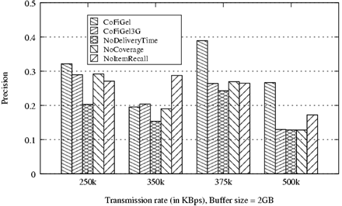
Precision
NoItemRecall has higher precision but loses out on coverage
On an average, CoFiGel outperforms baseline by 40%

Slide 39
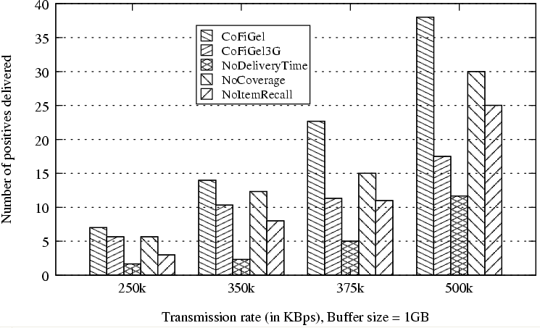
Item Delivery
On an average, CoFiGel outperforms baseline by 100%

Slide 40
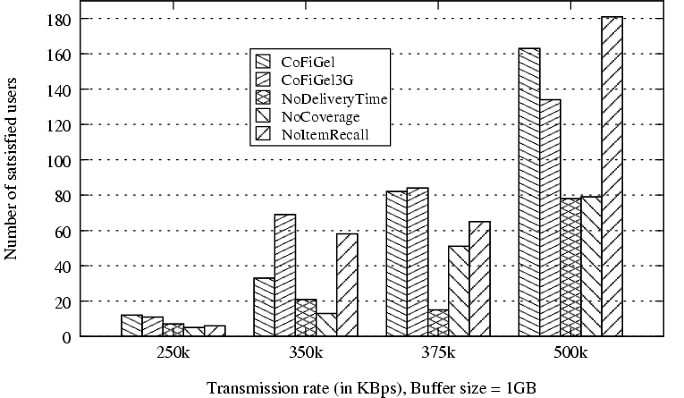
Number of Satisfied Users
NoItemRecall reaches more users but delivers less positive items. Also, does not contribute to coverage
On an average, CoFiGel outperforms baseline by 70%

Slide 41
Conclusion
We have proposed a M2M scheduling algorithm which:
Uses MCF for subjective characterization of content
Balances Coverage and User satisfaction under resource constraints
The algorithm is evaluated on two mobility traces and a popular rating dataset.
Results indicate at least 60% improvement in all metrics compared to baseline.

Slide 42
Thank You

Slide 43
Figure references
Slide 8:
http://buychargeall.com/wp-content/uploads/2012/08/Screenshot_19.jpg
Slide 4(top left):
http://www.goodjobcreations.com.sg/wp-content/uploads/2012/04/NUS-Lecture-29Mar12-2-1024x768.jpg
Slide 4(bottom right):
http://multimodal-analysis-lab.org/webGallery/intCollaborators.html
Slide 3:
http://4.bp.blogspot.com/_InT0mik0xu0/SjRhJFDhRQI/AAAAAAAABSM/XQVx6_hbCqE/s400/IMG_0503.jpg

